Slide 1
Prince William Sound Profiler Prototype
Scientific Shark
Notes:
Celeste

Slide 2
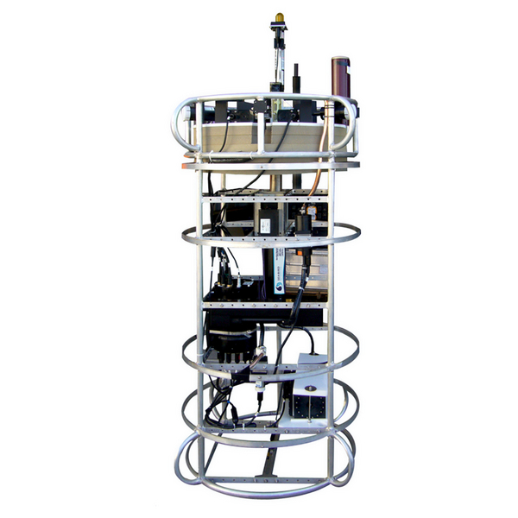
Roadmap
Introduction
System Block Diagram
Power Design
Communication Module
Processor
Current Status
Schedule
Cost Analysis
Questions
Notes:
Srushty

Slide 3
Introduction
Prince William Sound, Gulf of Alaska
Exxon-Valdez Oil Spill (1989)
Prince William Sound autonomous moored profiler
Pain points of the profiler
Our solution and proposal
Notes:
Nick
The Prince William Sound autonomous moored profiler (PWS profiler) has provided vital data regarding the health of marine ecosystems in the Prince William Sound of the Gulf of Alaska. In response to the 1989 Exxon Valdez oil spill which decimated wildlife populations in the area, the PWS profiler has administered long-term monitoring to assess the still lingering effects of this environmental catastrophe.
Despite being an overall success, the profiler has a variety of pain points that have concerned its scientists and has prompted calls for improvement.
Our team is developing a prototype for a new moored profiler that incorporates renewable energy in the form of a wave power generator which provides trickle charging to the device’s battery, as well as a communications box that will enable greater ranged data transmission capabilities.

Slide 4
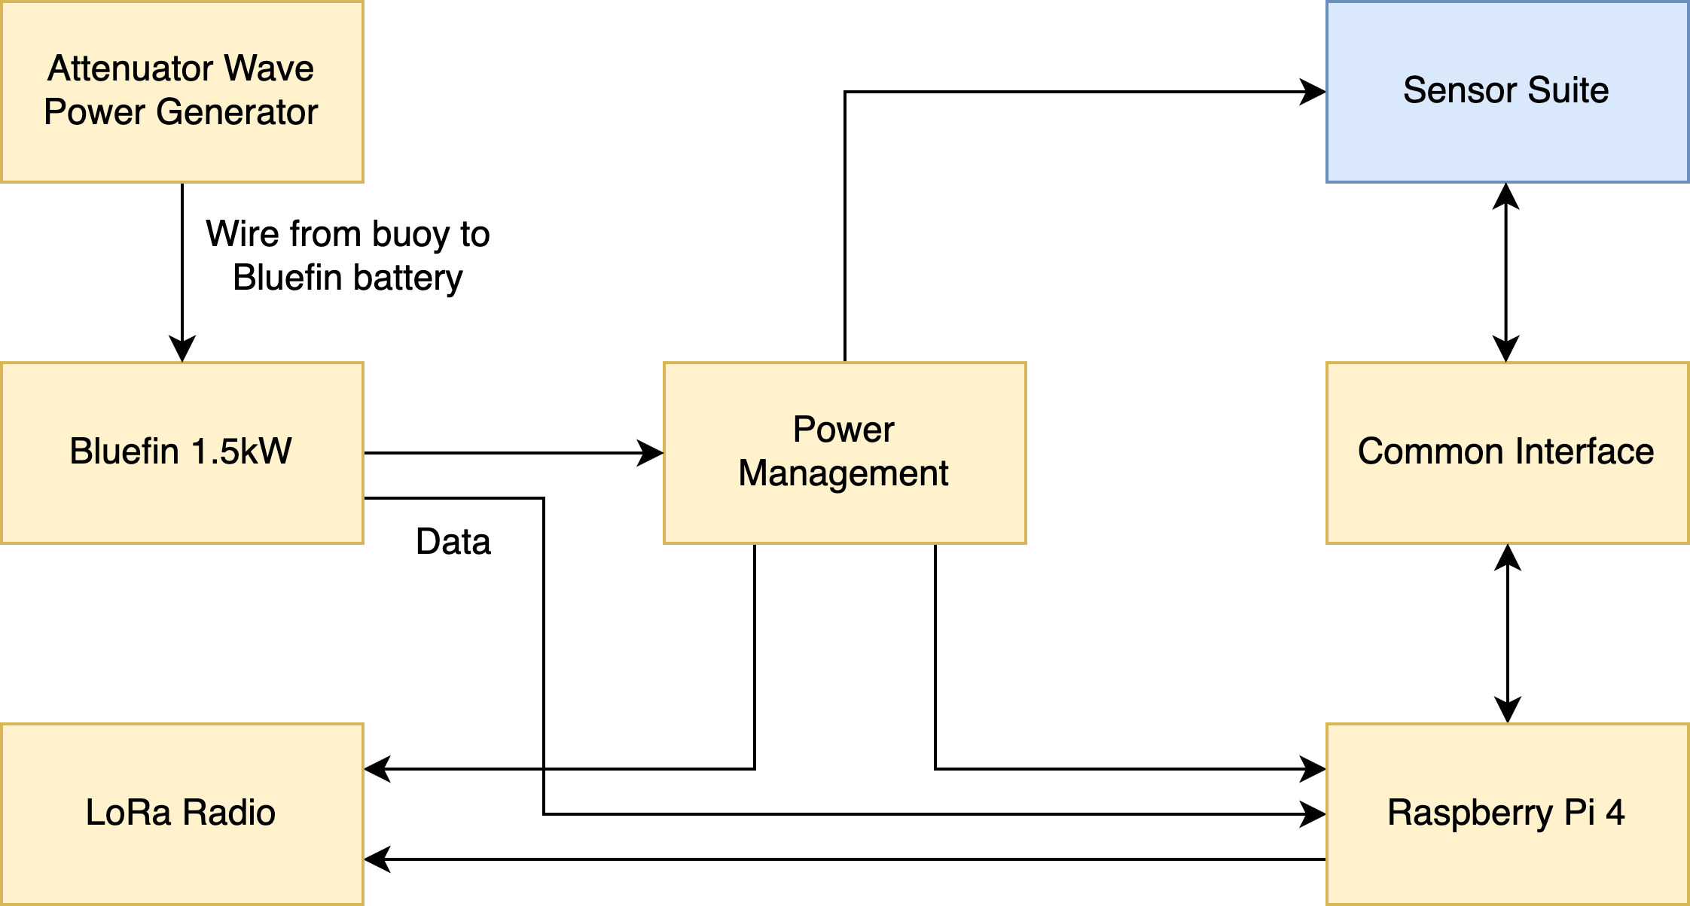
System Block Diagram
Notes:
Srushty
Project overview:
Communication box: Adafruit LoRa Radio Bonnet
Processor : RPi 4
Battery: 1.5kW
Wave power generator: Attenuators/ Linear Absorbers

Slide 5
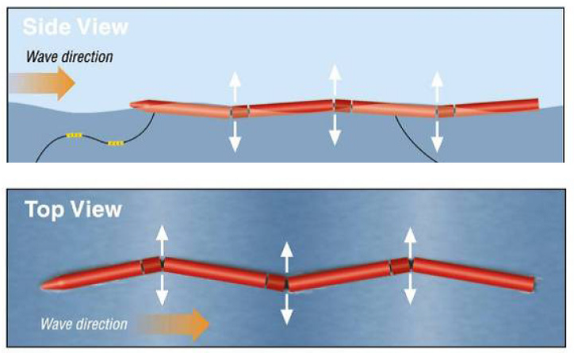
Design Solution: Power
Attenuator
Wave energy converters that are oriented parallel to the direction of wave travel
Rely on the flexing of joints to generate power
Subsea cable connected between attenuator and profiler for constant charge
Add-on
Notes:
Richard

Slide 6
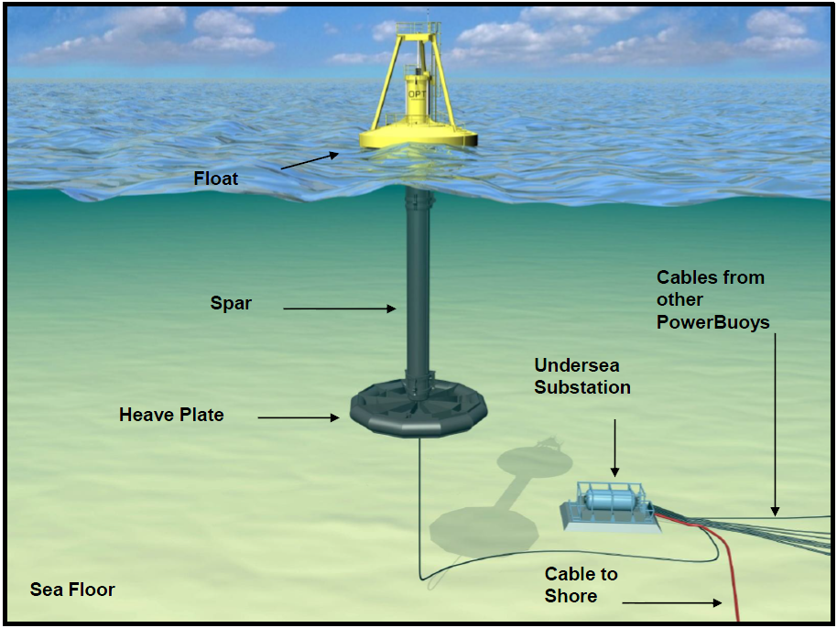
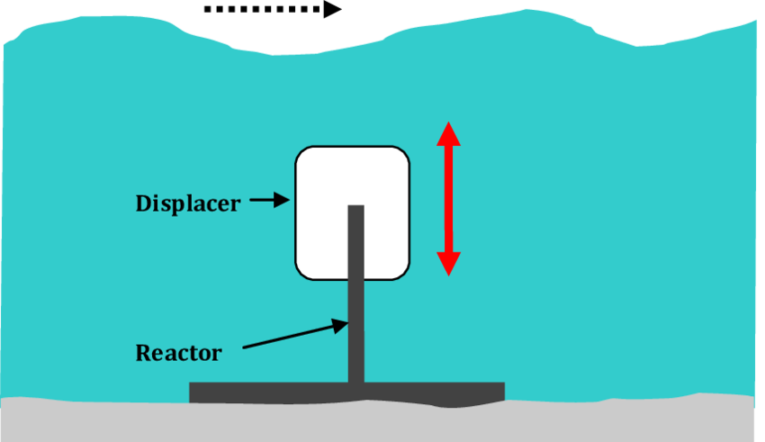
Design Alternative: Power
Point Absorber
Utilizes the motion of the surface waves to generate electricity
Resembles a buoy
One of the most common design types
Submerged Pressure Differential
Rests on or near the seafloor
Relies on pressure fluctuations as a wave passes overhead
Notes:
Rahil

Slide 7
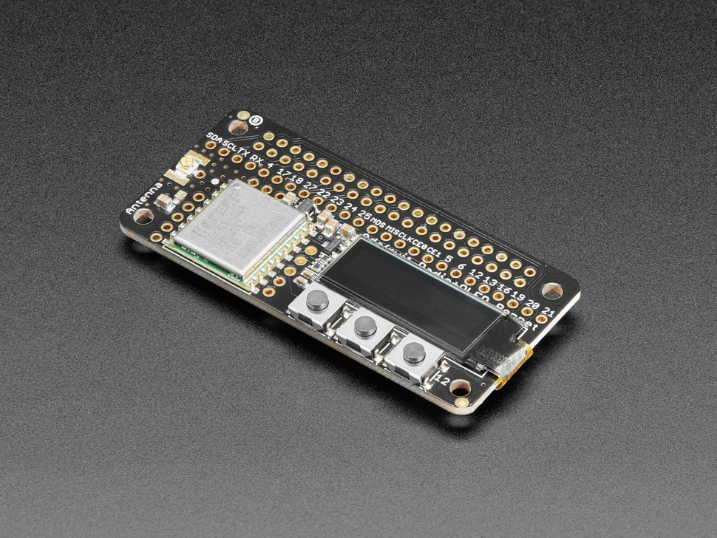
Design Solution: Communication Module
Not the main area of expertise
LoRa / LoRaWAN radio
2 Km line of sight
Up to 20 Km with directional antennas
SPI interface
868MHz or 915MHz transmission/ reception
Has prewritten libraries
Notes:
Celeste

Slide 8
Design Solution: Processor
 | RPi 4 | RPi 3 B+ | RPi 3 | Odroid C4 | BeagleBone Black
Power at idle | 540 mA (2.7 W) | 350 mA (1.9 W) | 260 mA (1.4 W) | 1.9 W | 290 mA (1.45 W)
400% CPU load | 1280 mA (6.4 W) | 980 mA (5.1 W) | 730 mA (3.7 W) | 3.1-3.3 W | -
Clock Speed | 1.5GHz | 1.4GHz | 1.4GHz | 2.0 GHz | 1.0 GHz
RAM | 1GB/2GB/4GB | 1GB | 1GB | 4GB | 512 MB
Notes:
Celeste

Slide 9
Status
Current Status
Design solution has been created
Major components have been selected
Wave Power Converter - Attenuator
Processor
Communications Module
Foreseeable Problems/Issues
Scaling down attenuator to meet project specifications
Supplying enough power to the system
Notes:
Por

Slide 10
Schedule
Notes:
Nick

Slide 11
Cost Analysis
Part | Count | Distributor/ Part Num | Cost per Unit | Total Cost
Raspberry Pi 4 | 1 | adafruit/4295 | $30* | $30*
LoRa Radio Bonnet | 2 | adafruit/4074 | $32.50 | $75
Piston | 1 | TBD | $100 | $100
Generator | 1 | TBD | $300 | $300
Rubber Tubes | 2 | TBD | $20 | $40
Battery | 1 | Inspired Energy | $202* | $202*
Total approximate price: $747 ($515 without battery or RPi)
Notes:
Celeste/Rahil/Richard(Rubber Tubes AND battery)

Slide 12
Citations
“About - Prince William Sound Science Center.” Prince William Sound Science Center. https://pwssc.org/about/ (accessed September 14 2020).
“Adafruit LoRa Radio Bonnet with OLED - RFM95W @ 915MHz,” Adafruit. [Online]. Available: https://www.adafruit.com/product/4074. (Accessed: 13-Sep-2020).
“BeagleBone Black.” Beagle Board. https://beagleboard.org/black. (accessed September 15, 2020).
J. Geerling. “Power Consumption Benchmarks.” Raspberry Pi Dramble. https://www.pidramble.com/wiki/benchmarks/power-consumption (accessed September 13, 2020).
“ODROID-C4.” ODROID. https://www.hardkernel.com/shop/odroid-c4/ (accessed September 15, 2020).
“Thetis Profiler.” Sea-Bird Scientific. https://www.seabird.com/systems/thetis-profiler/family?productCategoryId=54627869948 (accessed September 13, 2020).
“What is LoRa®?” Semtech. https://www.semtech.com/lora/what-is-lora (accessed September 13, 2020)
Faizal, M., Ahmed, M. and Lee, Y., “A Design Outline for Floating Point Absorber Wave Energy Converters,” Advances in Mechanical Engineering, vol. 6, Feb. 15, https://journals.sagepub.com/doi/10.1155/2014/846097 (accessed September 13, 2020).
“Energy And The Environment-A Coastal Perspective - Attenuators.” Coastal Energy And Environment.web.unc.edu. http://coastalenergyandenvironment.web.unc.edu/ocean-energy-generating-technologies/wave-energy/the-pelamis-wave-energy-converter/

Slide 13
Questions?

