Slide 1
Prince William Sound Moored Profiler Prototype

Slide 2
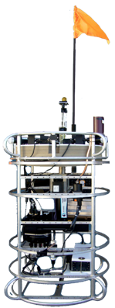
Introduction
Current System Problems:
Cannot remotely charge battery
Limited data transmission capability
Proprietary system
No longer supported
Our Approach:
Implemented point absorber power
generator
Integrated a communication module
to send data over long distances
Send data from instruments and battery
cells collected and show in on the UI
Figure 0. Seabird Scientific Autonomous Moored Profiler [3]
Notes:
Unfortunately, the current system has a number of problems so scientists at Prince William Sound turned to us to begin designing a new system. The biggest problems with the current system is that there is no remote charging capability, scientists must go out and charge the profiler every month, another problem is that there is limited data transmission, much of the data is collected when the scientists are charging the system, and the profiler is proprietary and is no longer supported by the manufacture
To overcome these challenges in the new system we will implement a point absorber power generator to continuously charge the battery, we will include radio module to remotely send data collected from the instruments and battery cells that will be received by a base station Raspberry Pi and shown on a User Interface

Slide 3
Our Team
Richard Nguyen
Electrical Engineer
Kombundit Chitranuwatkul
Electrical Engineer
Rahil Ajani
Electrical Engineer
Srushty Changela
Computer Engineer
Celeste Smith
Computer Engineer
Nicholas Nguyen
Computer Engineer
Notes:
Please meet our team that tackled this challenge, we are a group of 3 electrical engineers and 3 computer engineers

Slide 4
Notes:
Today, first we will go into specifics of the wave power generation device, then we will talk about the data monitoring system, we will then show videos of the demonstrations, talk about a cost analysis, and make suggestions for future work

Slide 5
Wave Power Generator
Figure 2. Magnet holder within the PVC pipe
Figure 3. CAD drawing of entire point absorber
Figure 4. Built point absorber
Notes:
For our point absorber wave power generation device the point absorber consists of 48 magnets meticulously arranged within a 3D printed holder enclosed, as seen in Figure 1, within a PVC pipe to maximize magnetic flux. To avoid excessive movement of the 3D printed magnet holder within the PVC, we 3D printed solid cylinders that were inputted on both sides of the PVC pipe in order to hold the magnet holder in place in the center. Outside the PVC pipe, we designed a middle float that has over 7000 coils winded inside of it to move up and down against the magnets from within the PVC pipe based on the ocean waves to generate power. In order to stop this middle float from exceeding magnet boundaries, we specifically placed stationary stoppers on each end of the PVC pipe to limit the range of motion of this float.

Slide 6
Charging Circuit
Figure 5. Schematic for the charging circuit
Notes:
There is a rectifying circuit between the wave generator and the battery that allows for safe charging. Our circuit consists of a piezoelectric energy harvester, 2 supercapacitors, resistors, a NMOS, diodes, a boost converter and a battery power management board
There is a rectifying circuit between the wave power generator and the battery that allows for safe charging. Our circuit consists of a piezoelectric energy harvester, 2 supercapacitors, resistors, a NMOS, a boost converter and a battery power management board. The way it works is that the piezoelectric energy harvester is connected to two super capacitors connected in series, which will store the power being supplied from the point absorber until they hit a certain threshold. Once that happens, the switch will close allowing for the super capacitors to discharge. This will then send power to the boost converter, then to the battery power management board, which will light up verifying that the battery is being charged, and allow safe charging.

Slide 7
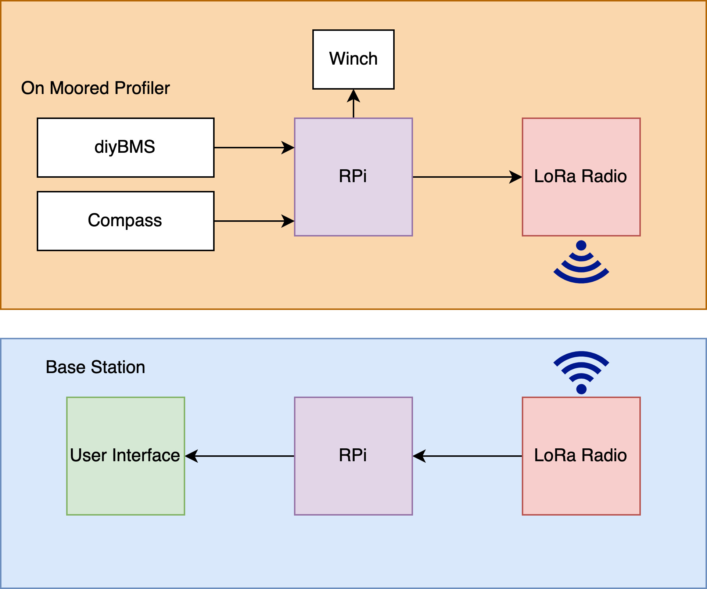
Data Monitoring System
BMS
Notes:
Next, we have an overview of the communicating components on the prototype moored profiler and the base station. On the top, in the orange box are all the subcomponents on the prototype profiler, on the left we have the Battery management Boards which monitor the voltage and temperature of the batteries and report it to the Raspberry pi, under that we have an example instrument, a digital compass, that collects various readings and sends them to the raspberry pi. Next we have a winch that the raspberry pi commands to raise and lower the profiler. Finally, when the profiler is at the surface the LoRa Radio transmits data from the battery management system and compass back to the base station.
When the base station receives data the Raspberry Pi parses the data, stores it in txt files and displays it in graphs on the user interface

Slide 8
Wave Power Generator Demo

Slide 9
Data Monitoring Demo

Slide 10
Integrated System

Slide 11
Cost Analysis
Topics | Materials | Quality | Total Price
Power Generator | Temflex 3/4 in. x 60 ft. 1700 Electrical Tape Black | 1 | $1.78
 | Rare Earth 3/4 in. x 1/4 in. Disc Magnet (4-Pack) | 12 | $190.42
 | 2 in. PVC Schedule 40 S x S Coupling | 2 | $1.96
 | 2 in. x 24 in. PVC Sch. 40 DWV Pipe | 1 | $4.96
 | 16 oz. Gaps and Cracks Insulating Foam Sealant with Quick Stop Straw | 1 | $4.08
 | J-B W Clearweld Epoxy Syringe 25 mL | 1 | $19.50
Battery Communication | Raspberry Pi 4 15W Power Supply | 1 | $8.47
Radio Communication | Adafruit LoRa Radio Bonnet with OLED | 2 | $80.72
 |  | Total | $311.89
Notes:
With a total budget of $700, we only spent $311.89 on our system. Here you can see the breakdown of the cost, the biggest cost were the magnets for the generator device and the communication radios, however many items used in the prototype were provided by the labs at Georgia Tech and were not considered in the final cost

Slide 12
Future Work
Scale up the small unit scaled version of the power generation devices to implement the real version
Test the prototype in the real environment
Add additional software error checking
Add antennas to the radio that allows communication up to 20 km
Implement the mechanics of the winch
Notes:
There is a lot of future work to be done to get the system ready for scientists at prince william sound, some of this work includes

Slide 13
References
“The Exxon Valdez Oil Spill | Flashback | NBC News” NBC News, 30-June-2014. [Online]. Available: https://www.youtube.com/watch?v=A7hfQ8mTVrU. [Accessed: 22-Nov-2020].
“Photos and Sounds from Our Underwater Robot,” Prince William Sound Science Center, 16-Oct-2019. [Online]. Available: https://pwssc.org/photos-and-sounds-from-our-underwater-robot/. [Accessed: 22-Nov-2020].
R. Campbell. (2020). A Profiling Observatory for High Resolution Oceanographic, Biogeochemical, and Plankton Observations in Prince William Sound [PowerPoint Slides].

Slide 14
In 1989, an Exxon oil tanker hit a reef, spilling more than 11 million gallons of oil into Prince William Sound, devastating the ecosystem. A moored profiler was placed in the sound to monitor the health of the ecosystem. Currently, the scientists must go out weekly to charge the profiler and download data. Our project is to design a prototype of a new profiler that includes an innovative way to charge the profiler and communicate the system over longer distances.

