Slide 1
Design Review Presentation
Scientific Shark Celeste Smith, Srushty Changela, Rahil Ajani, Nicholas Nguyen, Richard Nguyen, Kombundit Chitranuwatkul
Notes:
http://eceseniordesign2020fall.ece.gatech.edu/deliverables/proposalpresentation/2014fall/Christinas%20PDR%20lecture%20slides%20spring%202011a.pdf

Slide 2
Background
Prince William Sound, Gulf of Alaska
Exxon-Valdez Oil Spill (1989)
Environmental monitoring: Autonomous moored profiler
Current Problems:
Remotely charge battery
Data transmission capability
Proprietary system
Notes:
Por

Slide 3
Agenda
High Level Overview of Prototype
Power Generation
Battery Communications
Example Sensor, Compass
Wireless Communications
User Interface
Path to Completion, Schedule
Cost Analysis
Notes:
Por

Slide 4
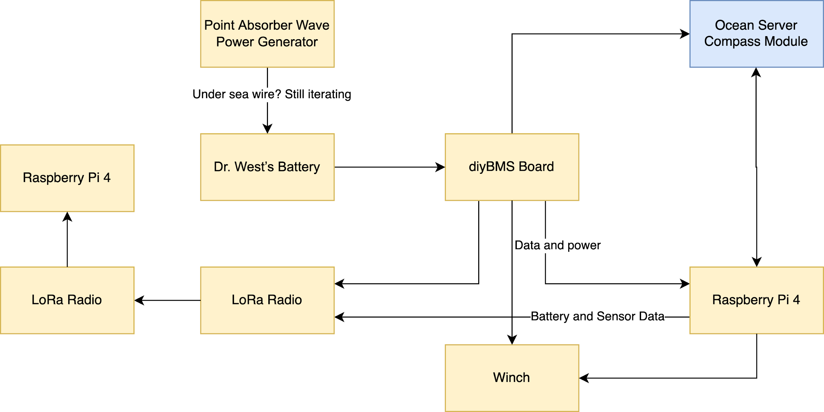
Block Diagram of Planned Prototype
Notes:
Celeste

Slide 5
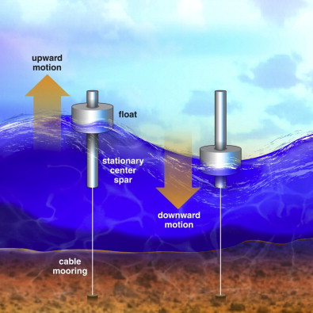
Power Generator
Point absorber instead of wave attenuator
Structure
Buoy
Magnets in the middle tube
Stator float moving based on waves
Plates (doughnuts) to keep stator in place
Mooring to the seabed
Generator -> Charging system -> Battery
Visual example of point absorber
Notes:
Rahil
Image Reference: https://www.sciencedirect.com/science/article/abs/pii/S1364032111005351

Slide 6
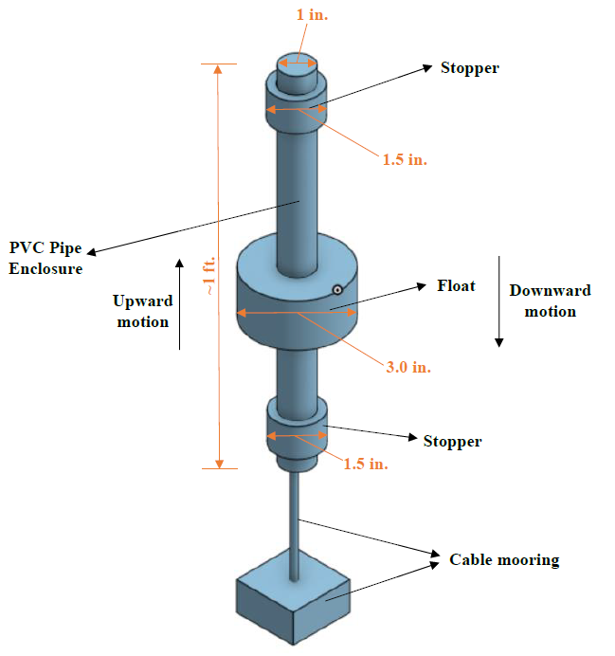
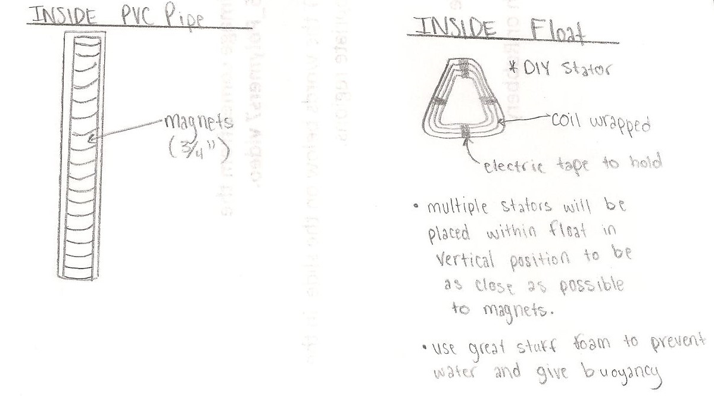
Power Generator Visual
Inside PVC:
Magnets stacked within
Inside Float:
DIY coil stators
3D print custom doughnuts and float
Mooring:
Cable and weight
Notes:
Richard

Slide 7
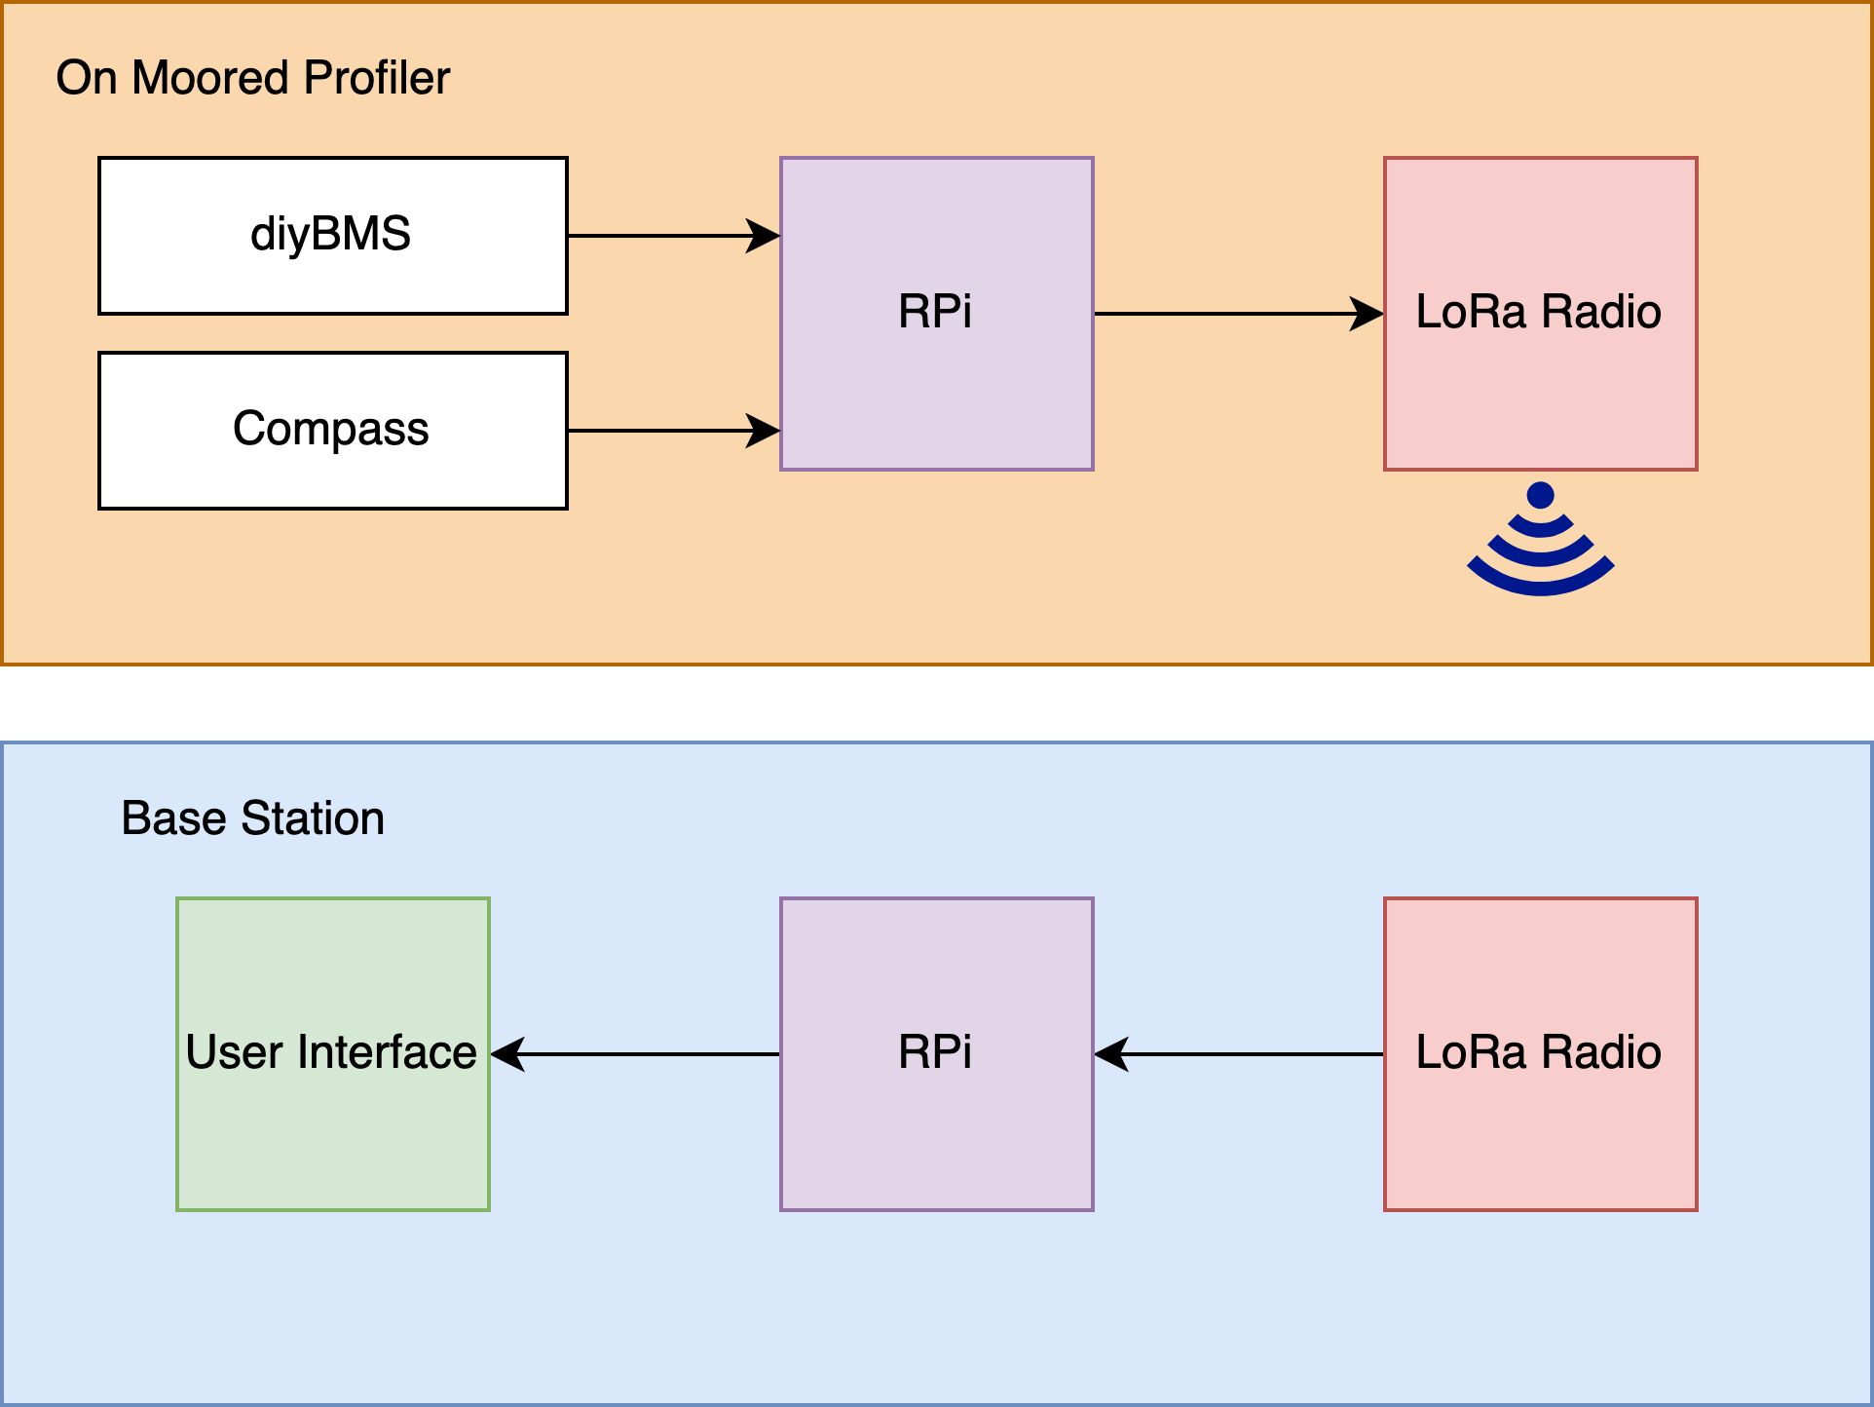
Software/Hardware Integration
Notes:
Nick

Slide 8
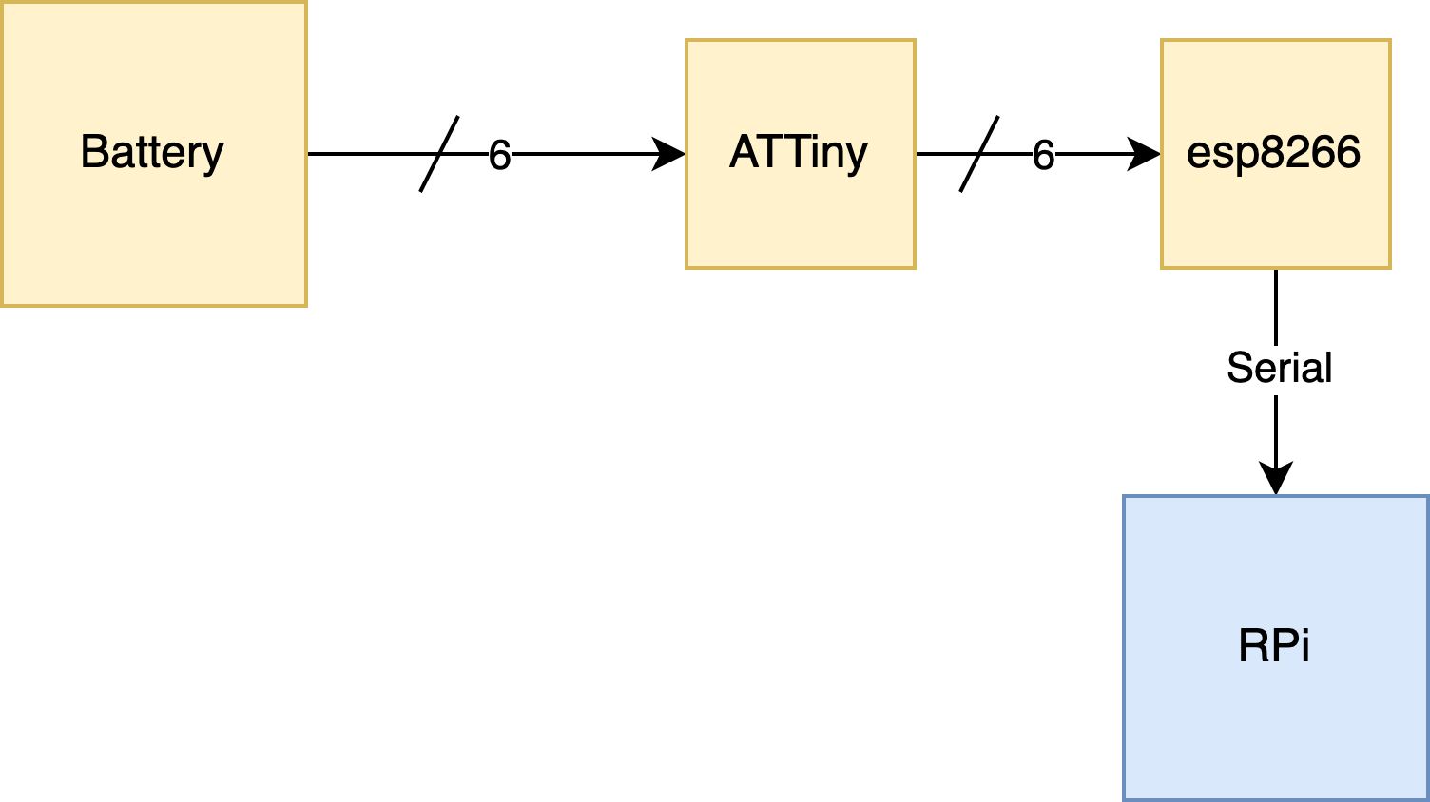
Battery Communication
/ 8
/ 8
Existing diyBMS code for the yellow boxes
Creating a bridge to the RPi
Use pyserial to get for each cell:
Temperature
Voltage
Current
Have code for RPi, need to test integrating it with physical board
Notes:
Celeste

Slide 9
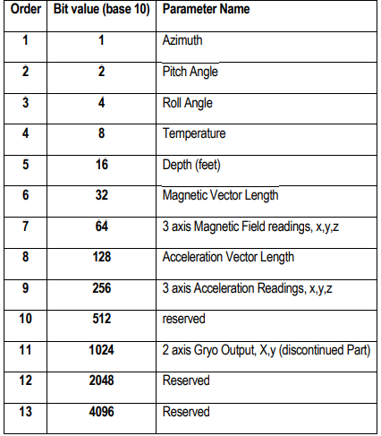
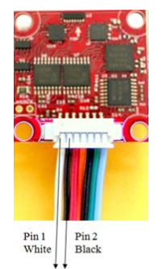
Compass
OS Compass
List of parameters from the compass
Notes:
Srushty

Slide 10
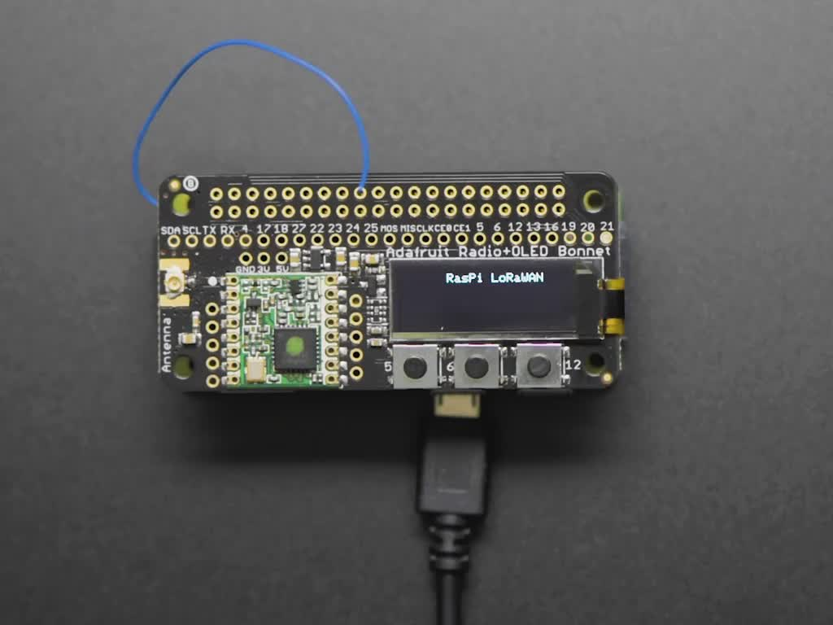
Radio
Long range (LoRa) transmission of packets, low power consumption
I2C protocol, 915 MHz but can be configured to other frequencies
Can utilize LoRaWAN (longer distance)
Still need to:
Send/receive information from battery management system and compass
Adafruit LoRa Radio Bonnet RFM95W
Notes:
Nick

Slide 11
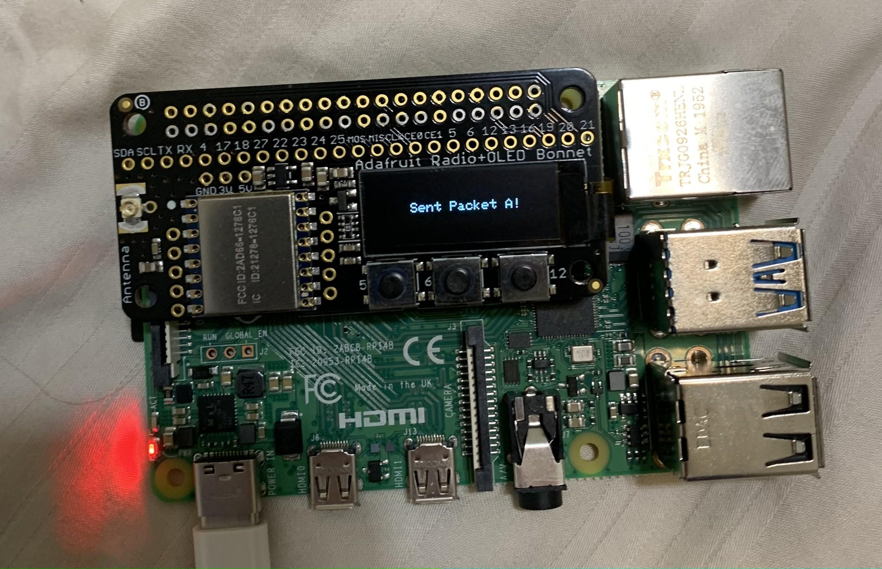
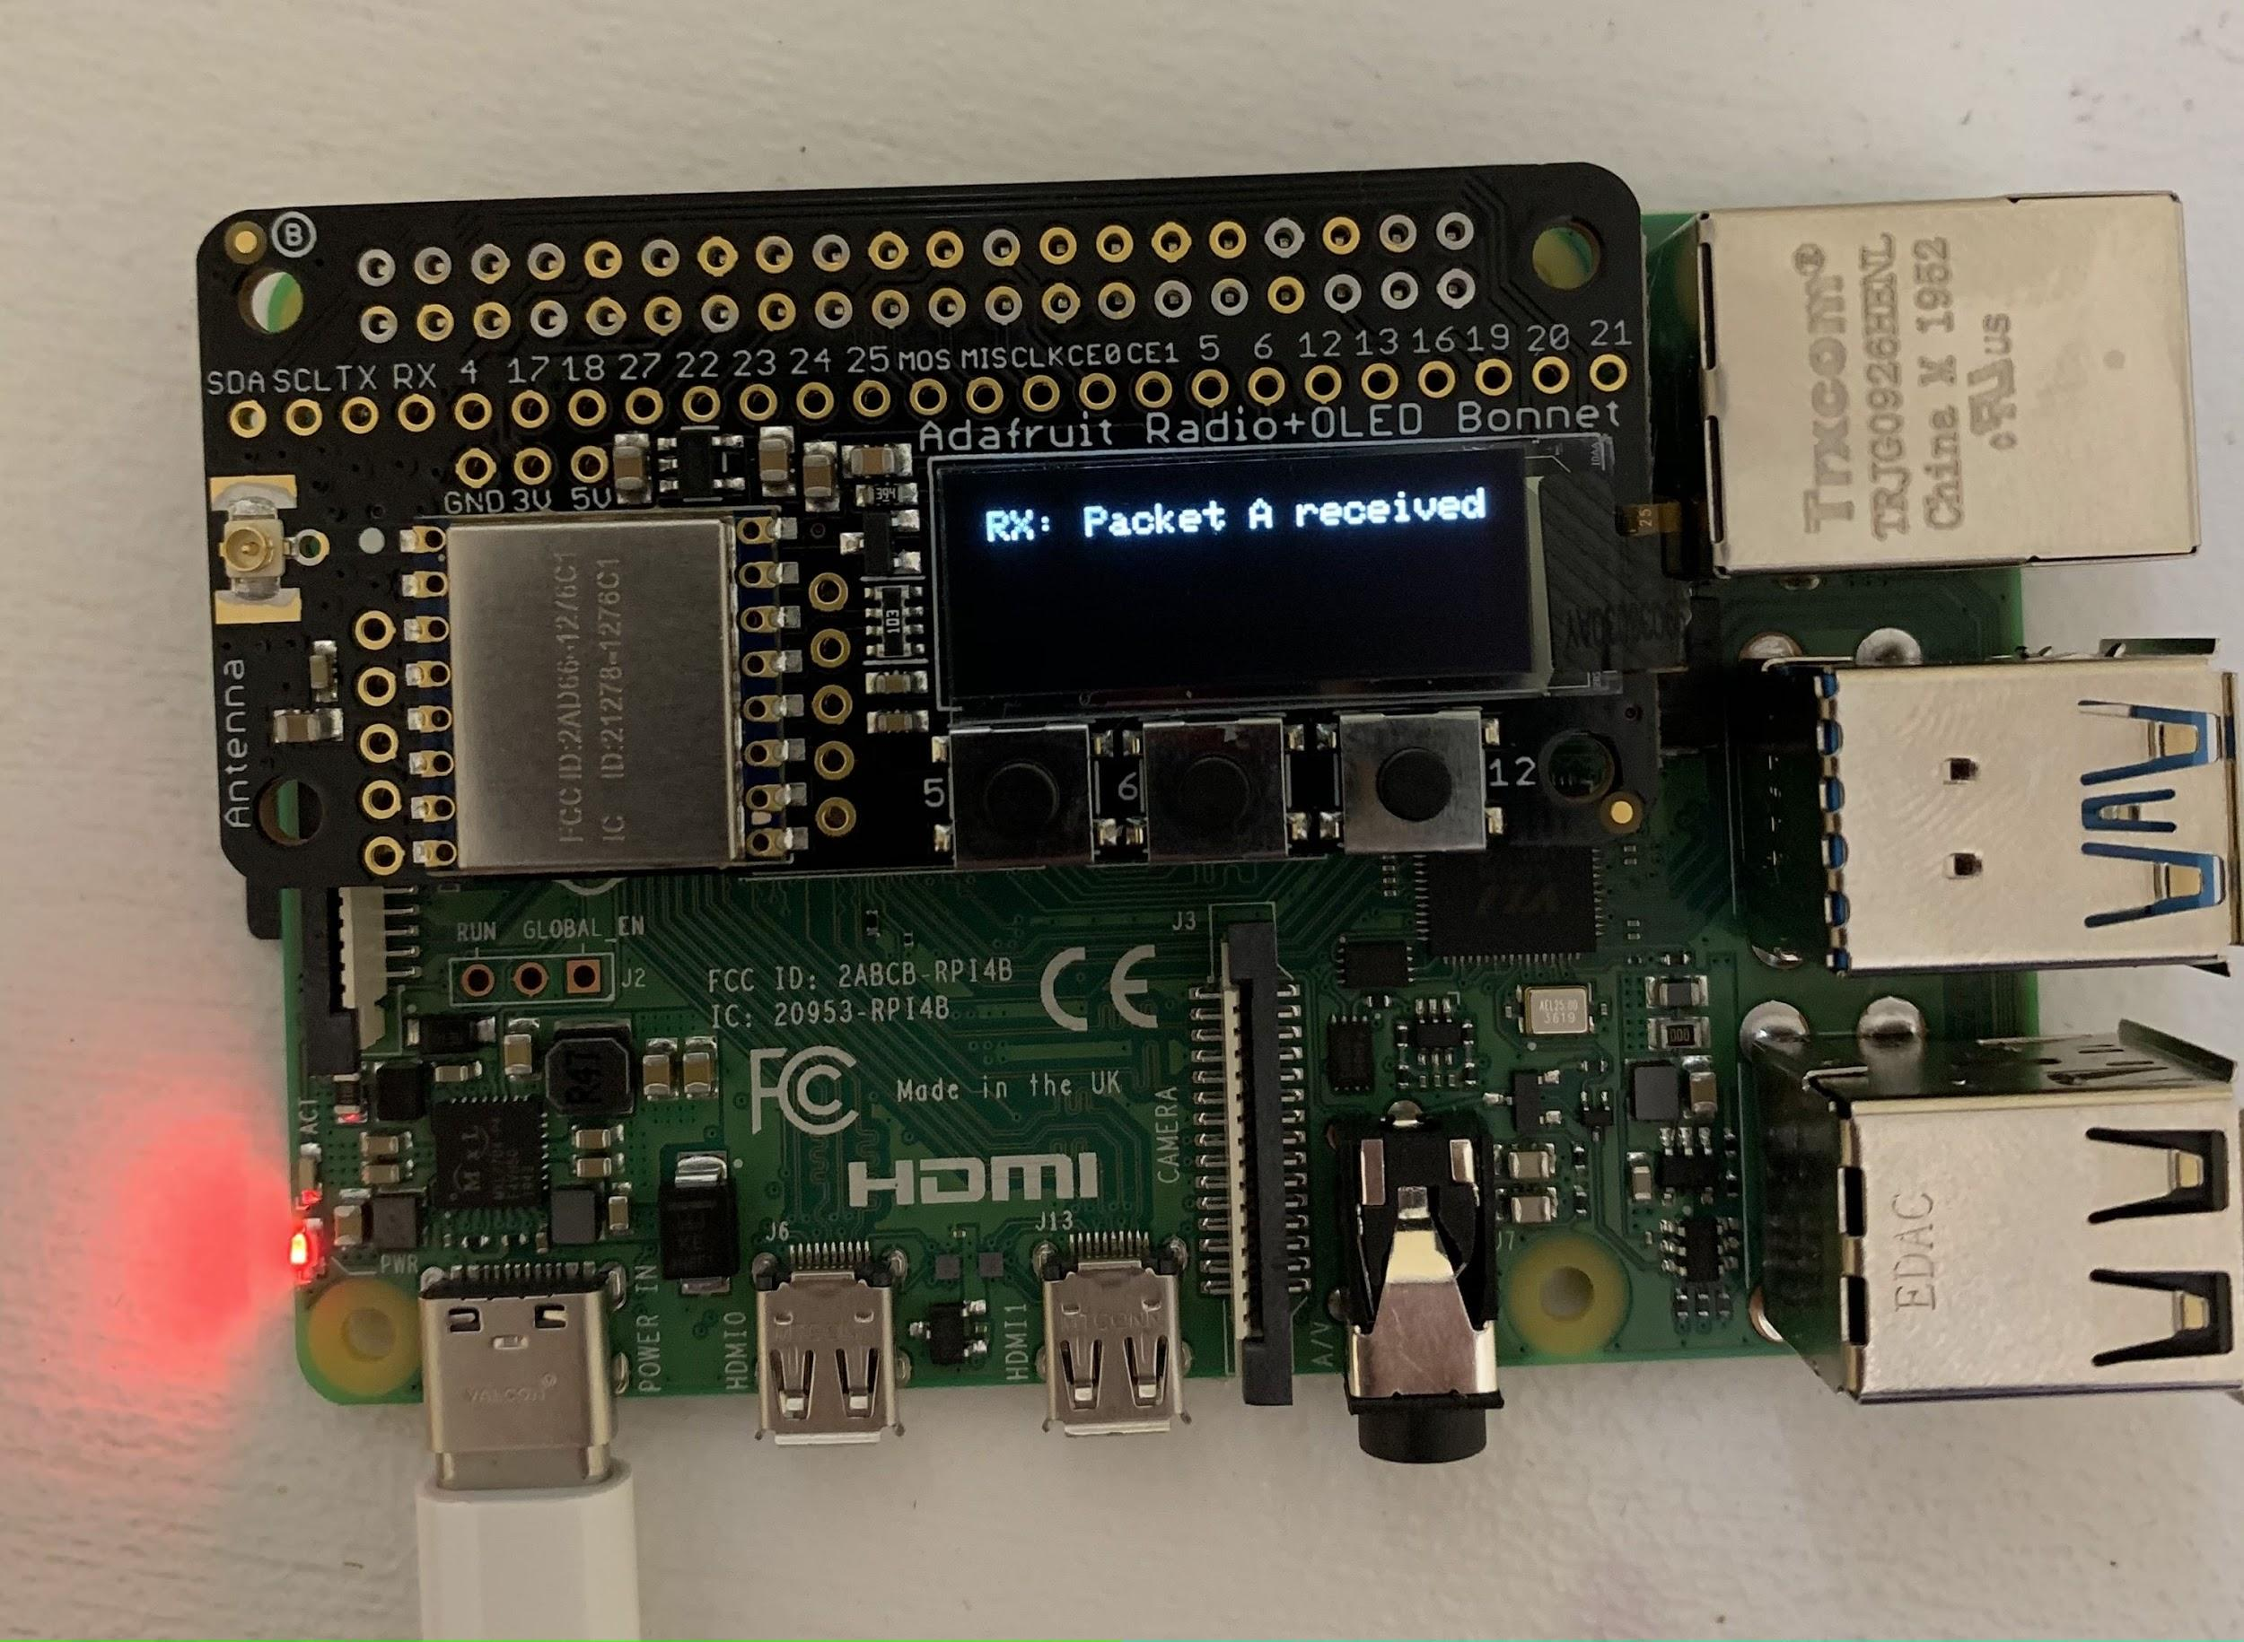
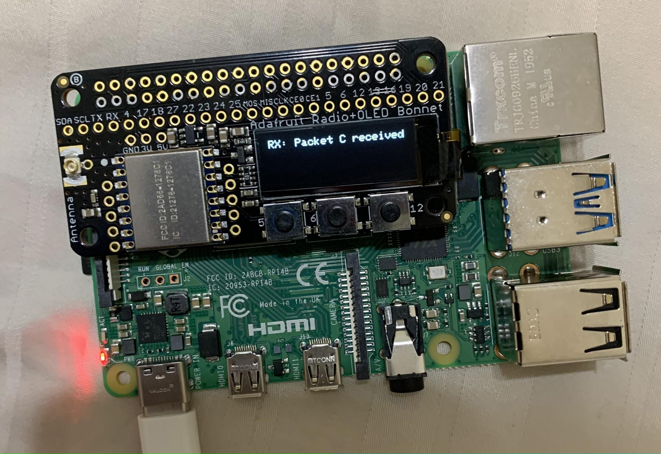
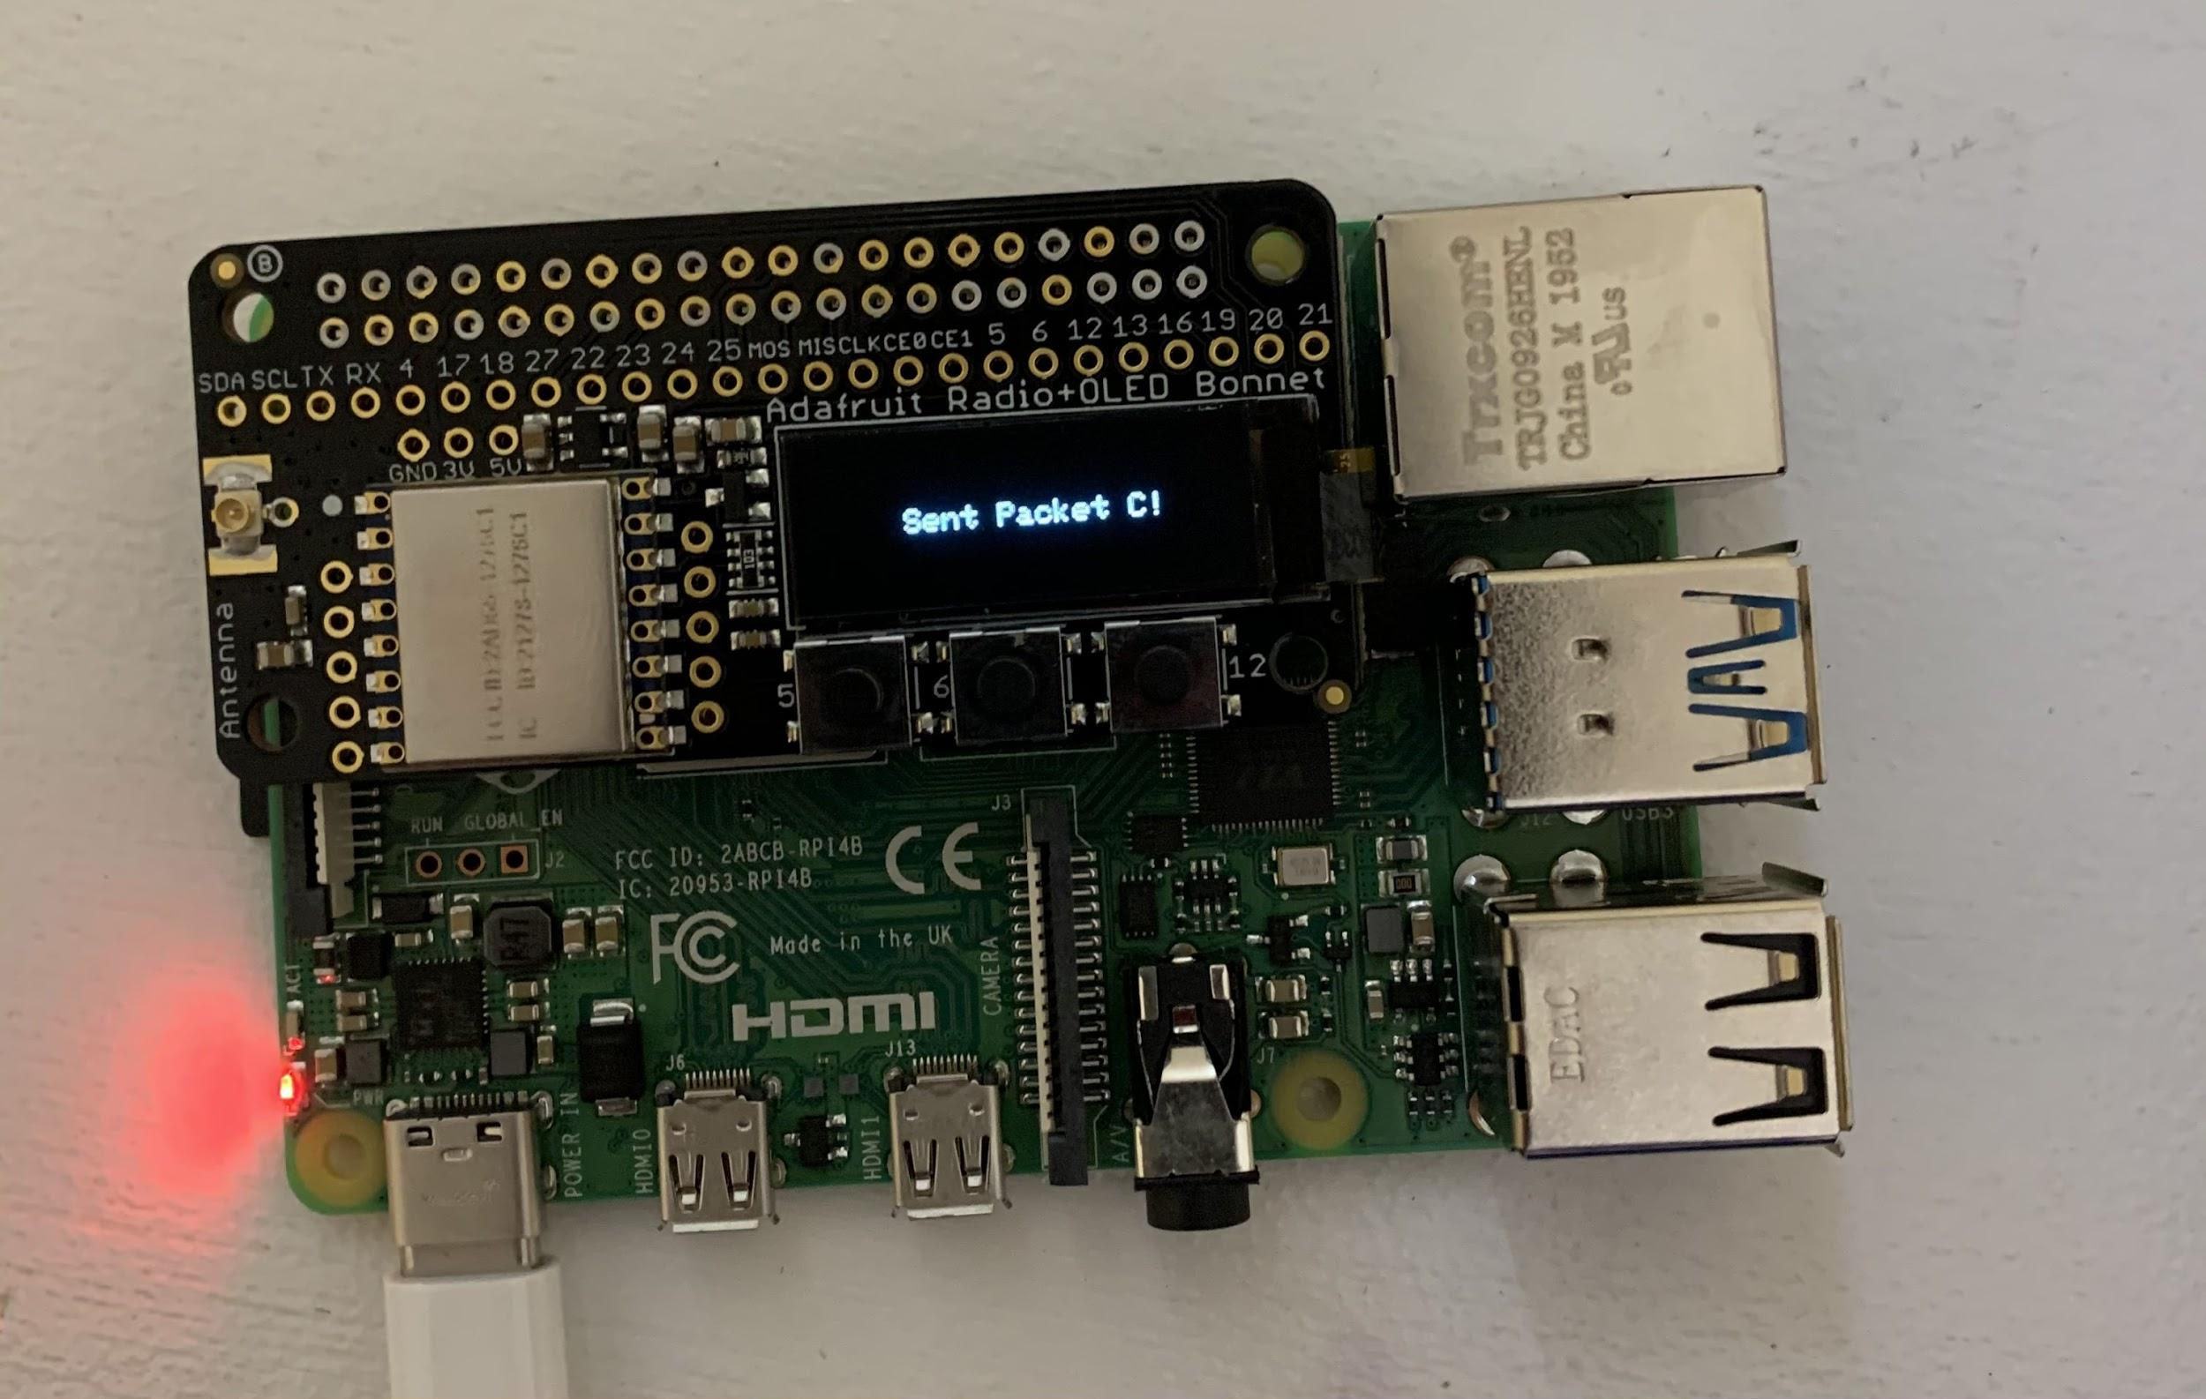
Radio
~4s
~1km
Radio 1 sends packet A
Radio 2 receives packet A
~4s
~1km
Radio 1 receives packet C
Radio 2 sends packet C
Notes:
Nick

Slide 12
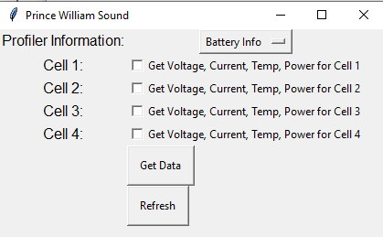
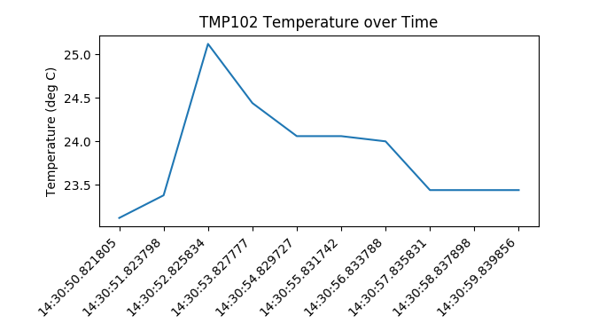
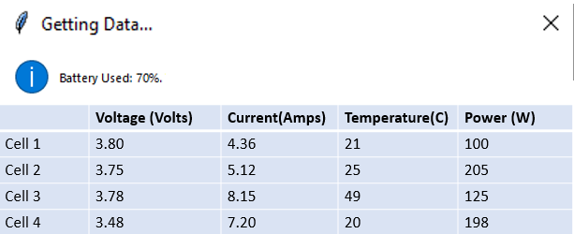
User Interface
Future GUI plans
Current GUI example
Notes:
Srushty

Slide 13
Pathway to Success: Schedule
Notes:
Richard

Slide 14
Cost Analysis: Bill of Materials
Topics | Materials | Quality | Total Price
Power Generator | Magnet | 10 | $89.30
 | Temflex 3/4 in. x 60 ft. 1700 Electrical Tape Black | 1 | $1.78
 | Rare Earth 3/4 in. x 1/4 in. Disc Magnet (4-Pack) | 1 | $190.42
Battery Communication | Raspberry Pi 4 15W Power Supply | 1 | $8.47
Radio Communication | Adafruit LoRa Radio Bonnet with OLED | 2 | $80.22
 |  | Total | $370.19
Notes:
Por

Slide 15
Reference
https://ocean-server.com/wp-content/uploads/2018/08/OS5000_Compass_Manual.pdf

Slide 16
Thank You!
Any Question?

