Slide 1
Semi-Autonomous Drone Surveillance
Sriharsha Singam (Group Leader), George Germanakos (Hardware Manager), Jerrin Kakkanatt (Financial Manager), Zach Mathews (Web Master)

Slide 2
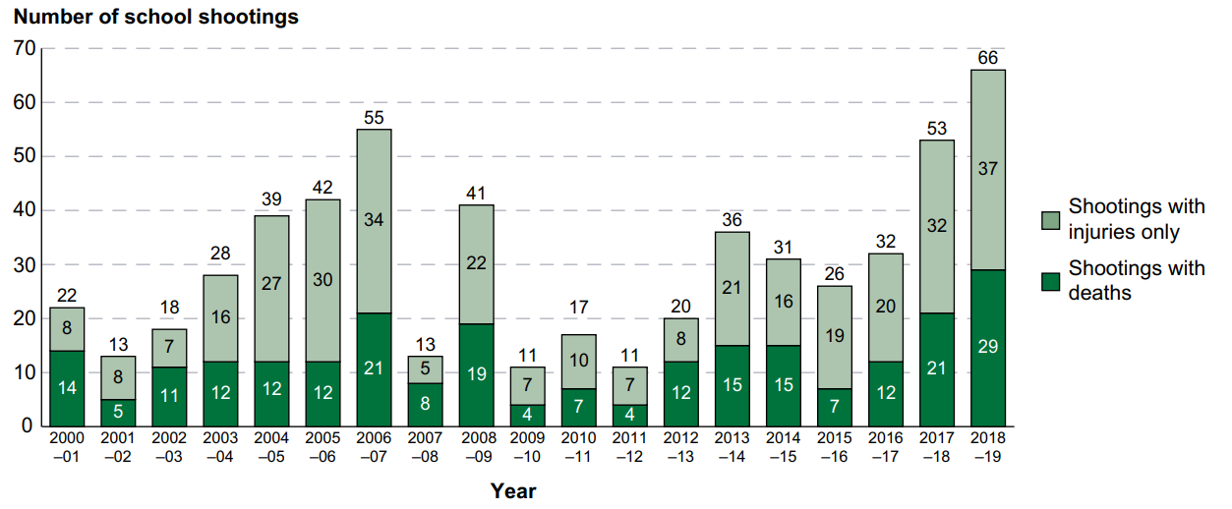
College Campus Safety
Problem: On-campus crime has seen an uptick within the last 3-5 years.

Slide 3
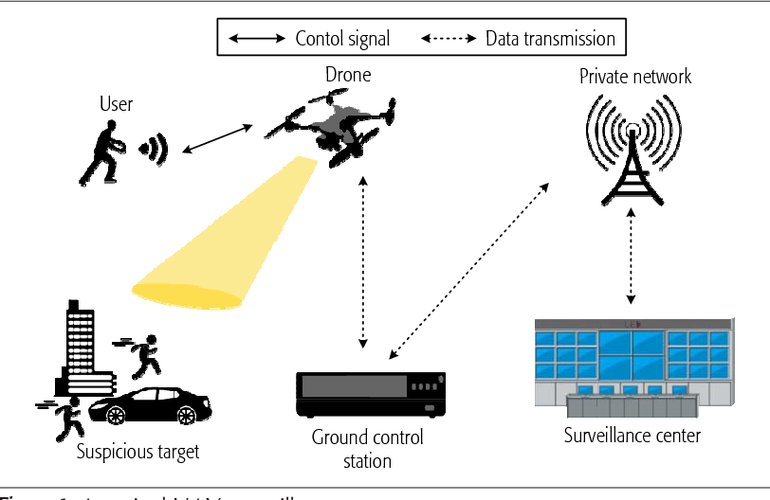
DroneBuddy
Drone that accompanies students to keep them safer by providing lights, sirens and quick contact to local police.

Slide 4
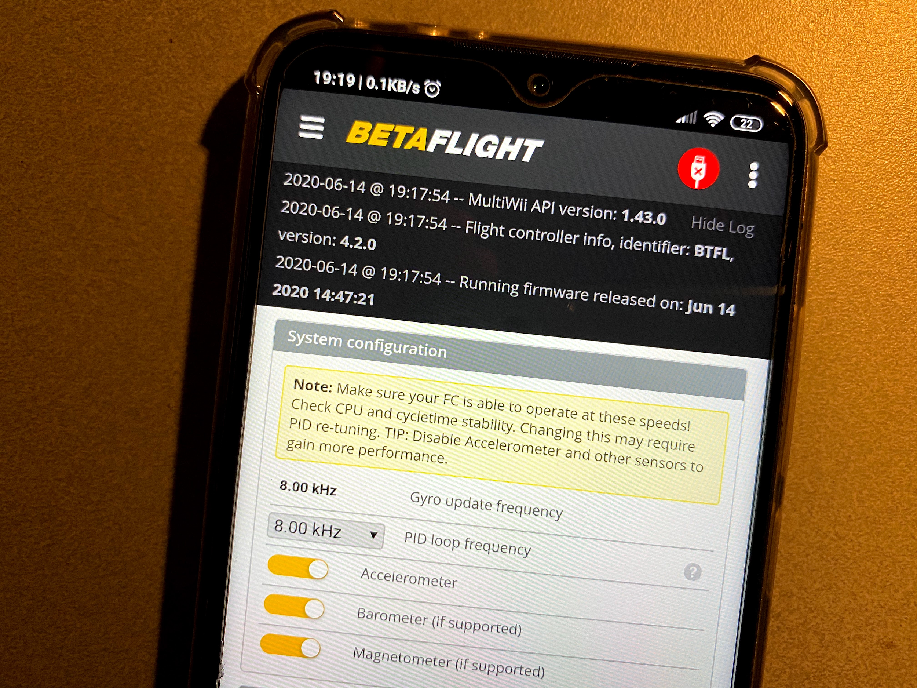
BetaFlight
Flight Controller Software
PID tuning
Rate adjustment
Configurable serial ports
Controls Drones Movements using Sensor Inputs
Open Source: github/betaflight
https://betaflight.com/news/betaflight-4.2-released/

Slide 5

Motion Detection and Tracking
OpenCV
Open source image processing library
Run on the drone in order to track human movements
Motion Detection and Tracking Algorithms
Motion Detection
  Dense Inverse Search
  Sparse Optical Flow
  Gunnar Farneback
https://opencv.org/
Tracking
  Kalman Filter

Slide 6
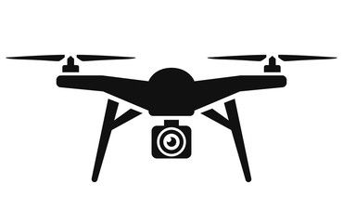
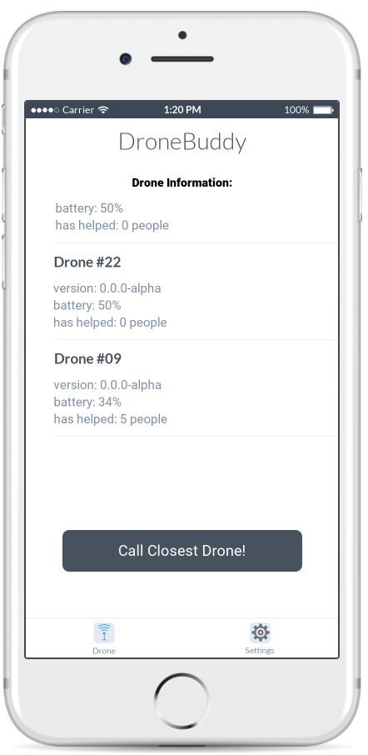
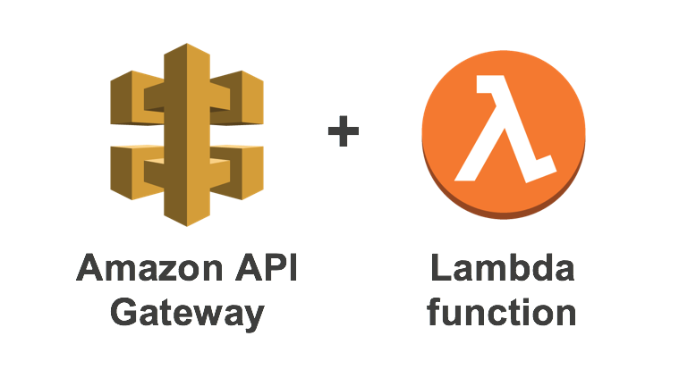
Surveillance Server
Use AWS to store surveillance data for later review and to handle user API calls.

Slide 7
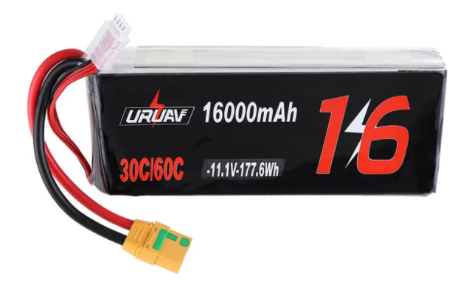
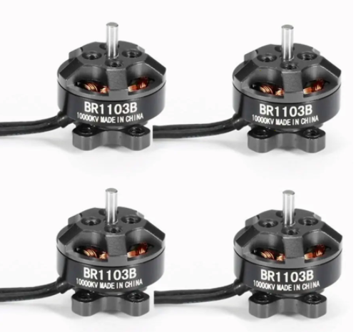
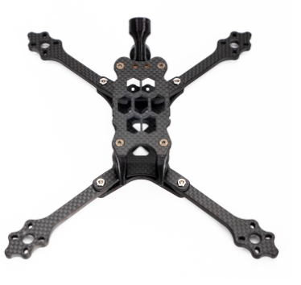
Drone Chassis
Battery pack will be used to power all the on board devices as well as the 4 propeller motors.
Quadcopter Configuration

Slide 8
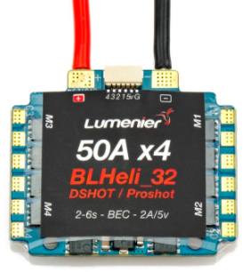
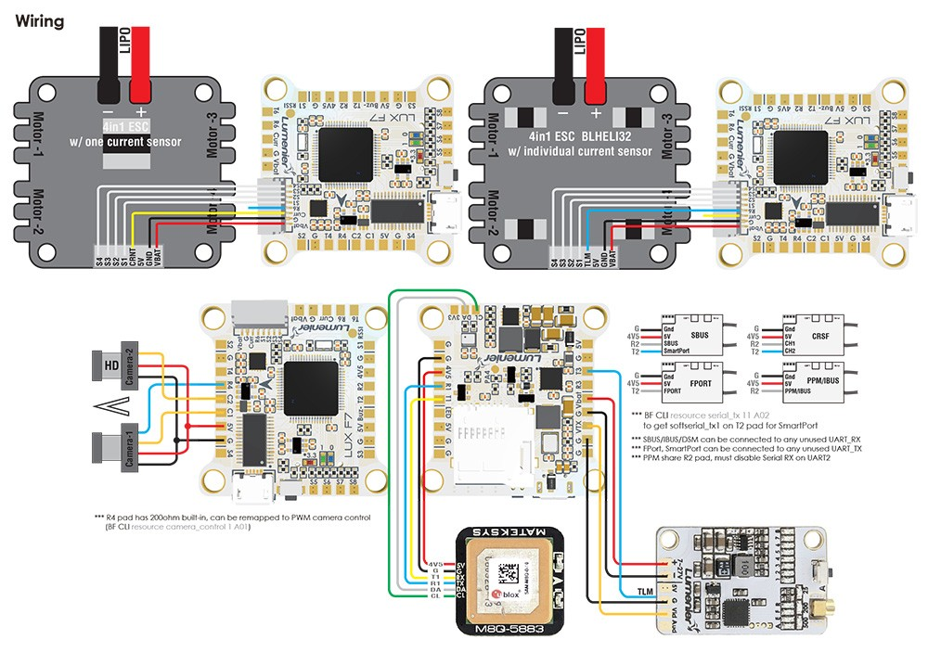
Programmable Flight Controller
Radio Transceiver, Electronic Speed Control
Flight Controller for ESC Motor Control, while communicating with Servers and the on board sensors.
Radio Transceiver
Notes:
George
Luminer LUX F7 - control the motors, gyro scope, cheap option
Radio Transciever

Slide 9
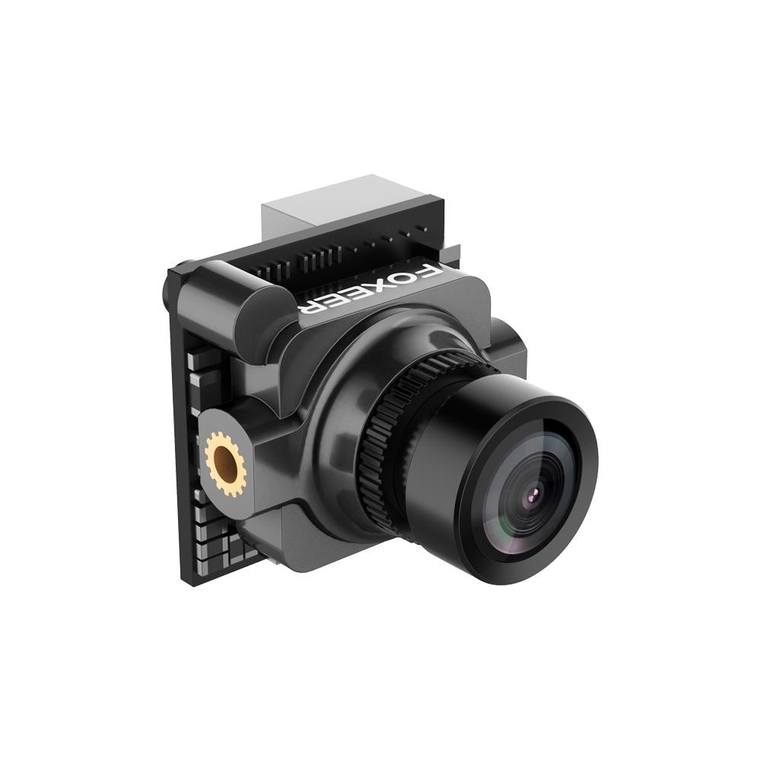
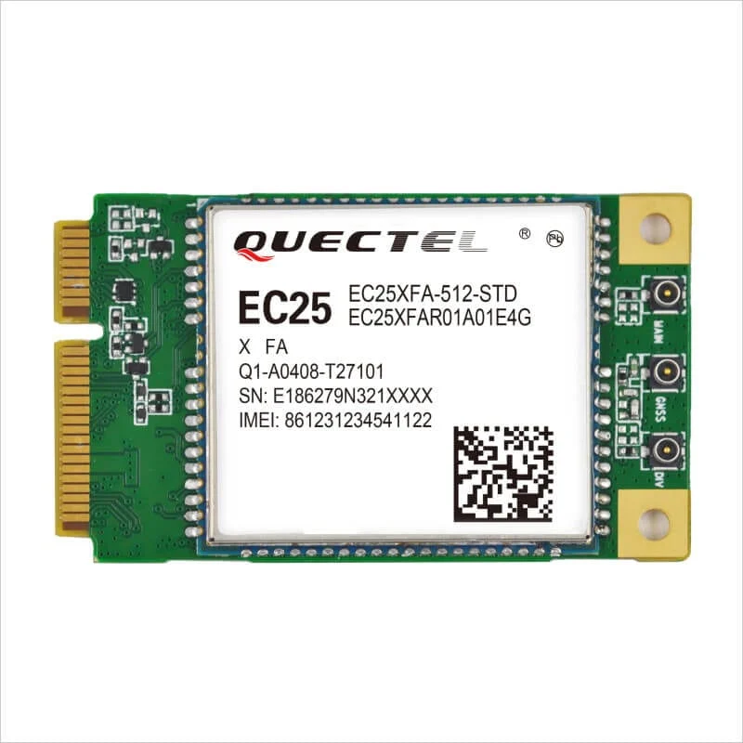
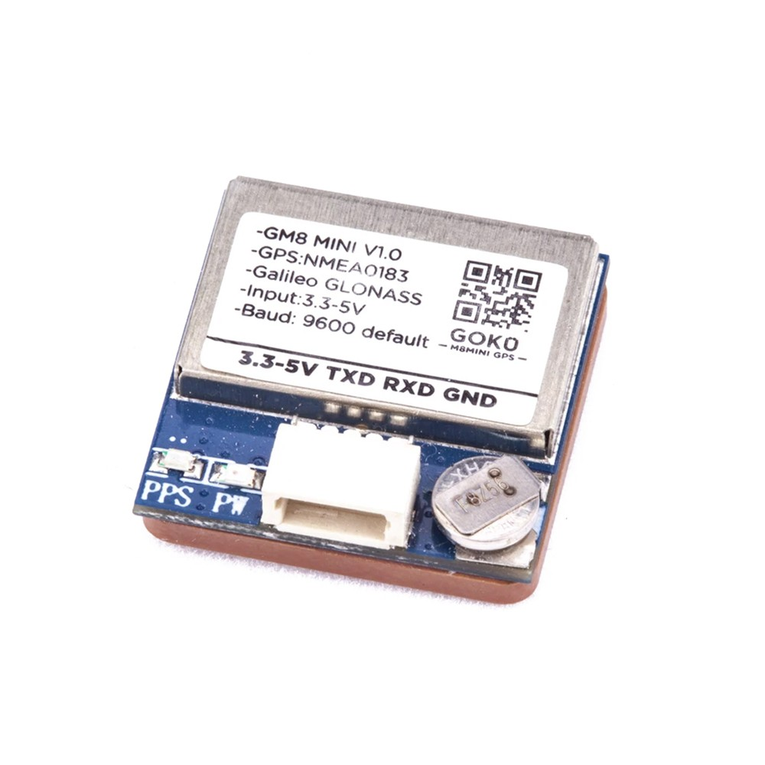
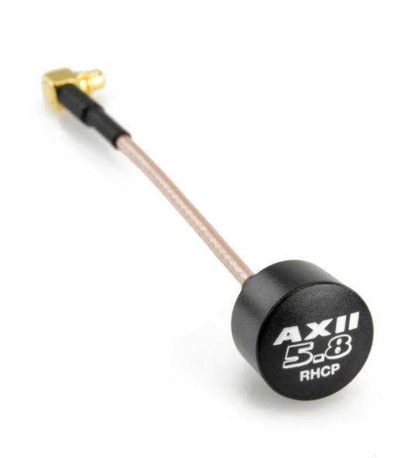
Radio Antenna, GPS, LTE Module, Camera
Telemetry, Communication and Motion Tracking to configure Drone’s Autonomous Movements
Camera
LTE Module
GPS
Radio Antenna
Notes:
George

Slide 10
App
Allow students to call a drone when they need safety while walking.
Communicates with Servers which then redirect a Drone.
Notes:
George

Slide 11
COVID19 Changes
Due to covid19:
Buy additional parts for everyone to use
Each team member will do a split of the work
Overview:
Chassis Construction and Parts Assembly
Motion Tracking using OpenCV
Telemetry Control, Calibration, and Usage
App, Server, and Drone communication

Slide 12

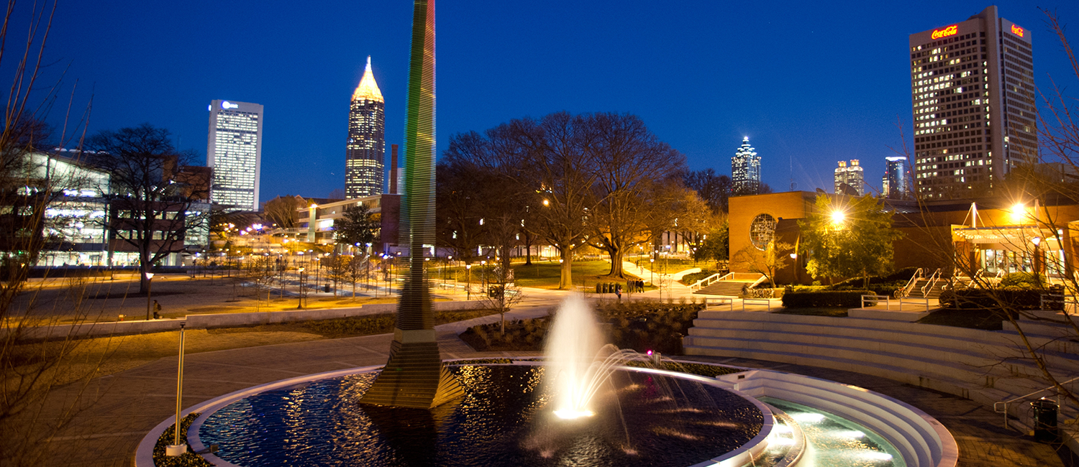
Drone Buddy Campus
Let’s create a safer campus for all.

