Slide 1
Drone Buddy: Semi-Autonomous Surveillance Drone
Sriharsha Singam, Zach Mathews, Jerrin Kakkanatt, George Germanakos

Slide 2
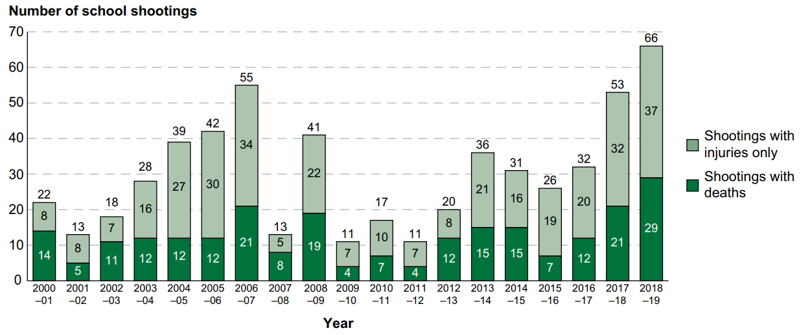
The Problem
Certain types of crimes have been steadily increasing in recent years
Hate crimes
Sexual Assault
Gun Violence
New, Innovative forms of security will need to be implemented in order to curb crime rates

Slide 3
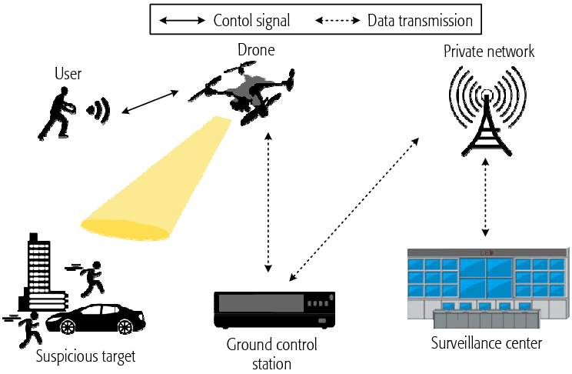
Our Solution - Drone Buddy
Semi-autonomous surveillance drone
Called in through our mobile app
Flies to the victim once called upon
Records footage
Follows the victim
Returns once released

Slide 4
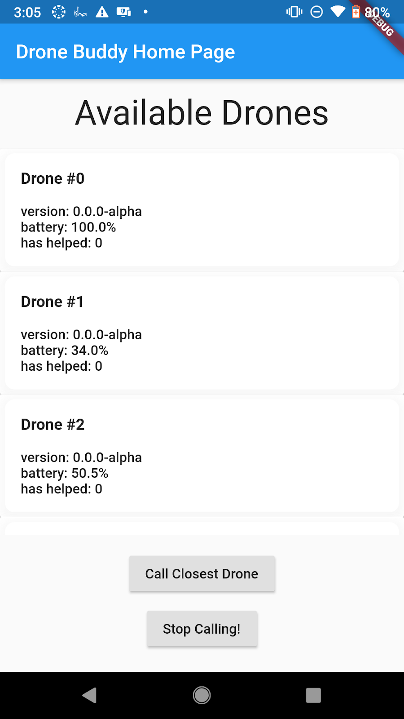
Mobile App
Students can call in a drone when they feel unsafe
Late at night walking alone
Drone Buddy uses the phone GPS though the app to locate and fly to the Student
Students will be able to register with their school ID

Slide 5
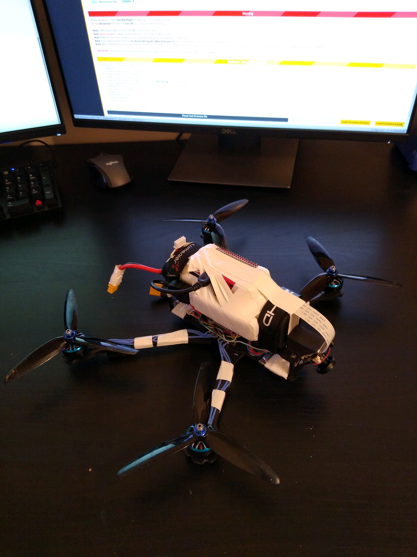
Drone Features
14.8 V Li-Ion Battery
Quad Copter
Flight Controller
Video Camera
4G LTE Capable
Raspberry Pi

Slide 6
Creation Process
Weekly meetings discussing team members roles and responsibilities
Github and Betaflight’s community feature were used to share code since one member was remote
Soldering and assembly of drone took place in Georgia Tech’s design studio
Georgia Tech’s 3D printer used to create camera mounts and cases for electronic components
Testing and practice runs done outdoors at Tech Green and Piedmont Park

Slide 7
Issues
COVID-19
One member caught it and became very sick
One member stayed remote entirely
Ordered extra parts so that it could be tested remotely by all members
Meetings in person were limited
Incompatible Parts
Despite research initial camera, speed controller, and magnetometer were replaced
Bricked Flight Controller

Slide 8
Future Improvements
Lights and sound
Can be used to further deter violent crimes
Wireless charging station for convenience
Weather resistant cover
Image based motion tracking detection

